Slide 1


Iterators
Building custom iterators in C++

Slide 2



Interlude
The next and last design pattern is the Visitor pattern. A main component of it is having a way to iterate through the object structure. To do that we need to build an iterator

Slide 3

What is an iterator?
An iterator is an object that points to an element inside a container.
The primary use of an iterator is to allow algorithms to manipulate the data inside a container, independent of the container type.
While can be like pointers in functionality, iterators can be complex objects not just simple variables that store a memory address.
Unlike pointers, iterators are not responsible for deleting the elements they point to. That responsibility falls under the container.

Slide 4

Iterator category
There are 5 types of iterators: Input, Output, Forward, Bidirectional and Random-Access. Container templates in C++ mainly support two of them:
Bidirectional: Allow for iteration through the data in two directions, however access is sequential in as that the iterator only provides instant access to the target bin within a container and its immediate neighbors
Random-Access: These function like pointer in as that access is not limited to sequential access, but elements can be accessed directly

Slide 5
Containers by category
Bidirectional
Random-Access
List
Map
Multimap
Set
Multiset
Vector
Deque
Note: Stack, Queue and Priority-Queue don’t support iterators

Slide 6
Benefits of iterators

Slide 7
Convenience and Reusability
// Declaring a vector
vector<int> v = { 1, 2, 3 };
// Declaring an iterator
vector<int>::iterator i;
int j;
for (j = 0; j < 3; ++j)
{
cout << v[j] << " ";
}
// Accessing the elements using iterators
for (i = v.begin(); i != v.end(); ++i)
{
cout << *i << " ";
}

Slide 8
Dynamic processing of the container
// Inserting element using iterators
for (i = v.begin(); i != v.end(); ++i) {
if (i == v.begin()) {
i = v.insert(i, 5);
// inserting 5 at the beginning of v
}
}
// Deleting an element using iterators
for (i = v.begin(); i != v.end(); ++i) {
if (i == v.begin() + 1) {
i = v.erase(i);
// i now points to the element after the
// deleted element
}
}
// Accessing the elements using iterators
for (i = v.begin(); i != v.end(); ++i) {
cout << *i << " ";
}

Slide 9
Operations
Begin(): Return the beginning position of the container
End(): Return the after end position (the position after the last element)
Advance(iterator,inc): Increment the iterator position inc times
Next(iterator,inc): Like advance but doesn’t modify the iterator, returns a new one instead
Prev(iterator,dec): Like next but the new iterator points to the position of the original iterator minus dec
Inserter(container,iterator): Helps inserts elements into the container at the position pointed to by the iterator by returning an iterator to insertion position.

Slide 10
Example
vector<int> ar = { 1, 2, 3, 4, 5 };
vector<int> ar1 = {10, 20, 30};
// Two iterators, one pointing to the beginning and the other to the end of ar
vector<int>::iterator ptr = ar.begin()
vector<int>::iterator ftr = ar.end();
// it is a new iterator that points to 4 and it1 to 3 in ar
auto it = next(ptr, 3);
auto it1 = prev(ftr, 3);
//ptr will now point to 4
advance(ptr, 3);
// insert ar1 after 3rd position in ar
copy(ar1.begin(), ar1.end(), inserter(ar,ptr));
//ar now contains 1 2 3 10 20 30 4 5

Slide 11
Properties
STL compatible iterators in C++ need to have the following properties
Iterator_category: random-access, bidirectional, etc.
Difference_type: The distance between iterator steps. This will greatly be determined by the size of the container bin
Value_type: The data type for the values inside the container (int, char, etc.)
Pointer: An iterator has a pointer at its core, this will usually be consistent with the value type
Reference: Defines the reference of the value type

Slide 12
Reference
Iterators are part of the C++ Standard Template Library and building a custom one is an advanced programming topic. There are several sources with information on iterators though introductory books rarely mention them. Here is one book that explains iterators and is available through the UCR library’s online resources:
Advanced C++ Programming Cookbook by Rian Quinn, January 2020

Slide 13
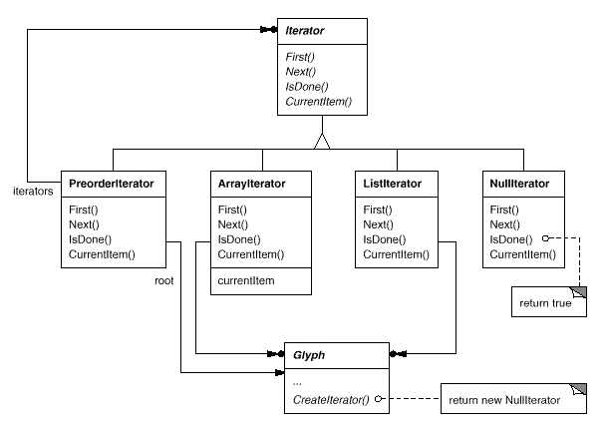
Iterator design pattern
The iterator design pattern is centered in encapsulating the behavior of accessing and traversing the children of classes in a system. Now that we know how a C++ iterator works, we can easily implement an iterator as defined by the Iterator pattern.

Slide 14

Disclaimer
The implementation shown in the following slides is better appreciated if you are looking at the actual code. The slides are here for reference and easy access

Slide 15
The Container
template <class T>
class Container {
friend class Iterator<T, Container>;
public:
void Add(T a) {
m_data_.push_back(a);
}
Iterator<T, Container> *CreateIterator() {
return new Iterator<T, Container>(this);
}
private:
std::vector<T> m_data_;
};

Slide 16
The Data
class Data {
public:
Data(int a = 0) : m_data_(a) {}
void set_data(int a) {
m_data_ = a;
}
int data() {
return m_data_;
}
private:
int m_data_;
};

Slide 17
The Iterator
template <typename T, typename U>
class Iterator {
public:
typedef typename std::vector<T>::iterator iter_type;
Iterator(U *p_data, bool reverse = false) : m_p_data_(p_data) {
m_it_ = m_p_data_->m_data_.begin();
}
void First() {
m_it_ = m_p_data_->m_data_.begin();
}
void Next() {
m_it_++;
}
bool IsDone() {
return (m_it_ == m_p_data_->m_data_.end());
}
iter_type Current() {
return m_it_;
}
private:
U *m_p_data_;
iter_type m_it_;
};

Slide 18

Questions?

